Slide 1
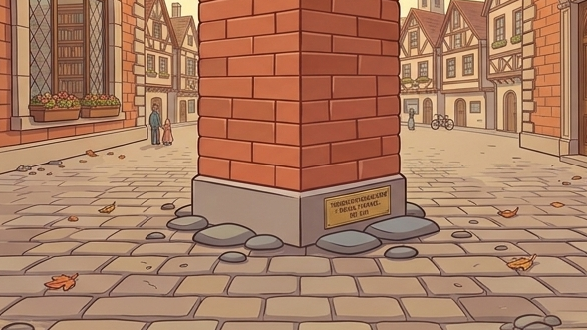
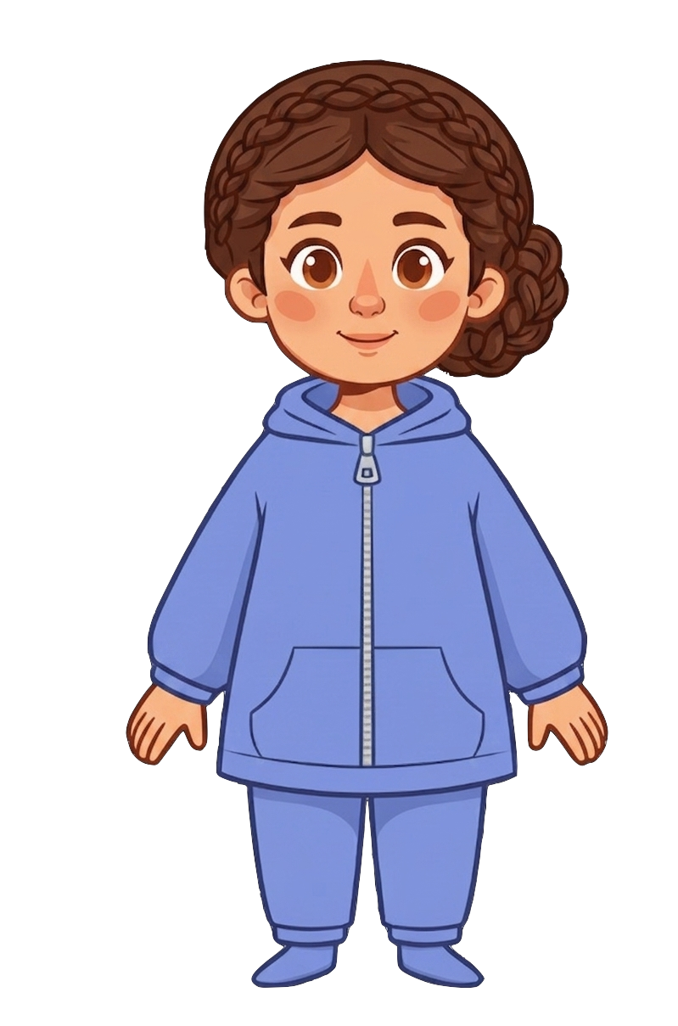
This is Catherine

Slide 2


Catherine has 7 cookies

Slide 3
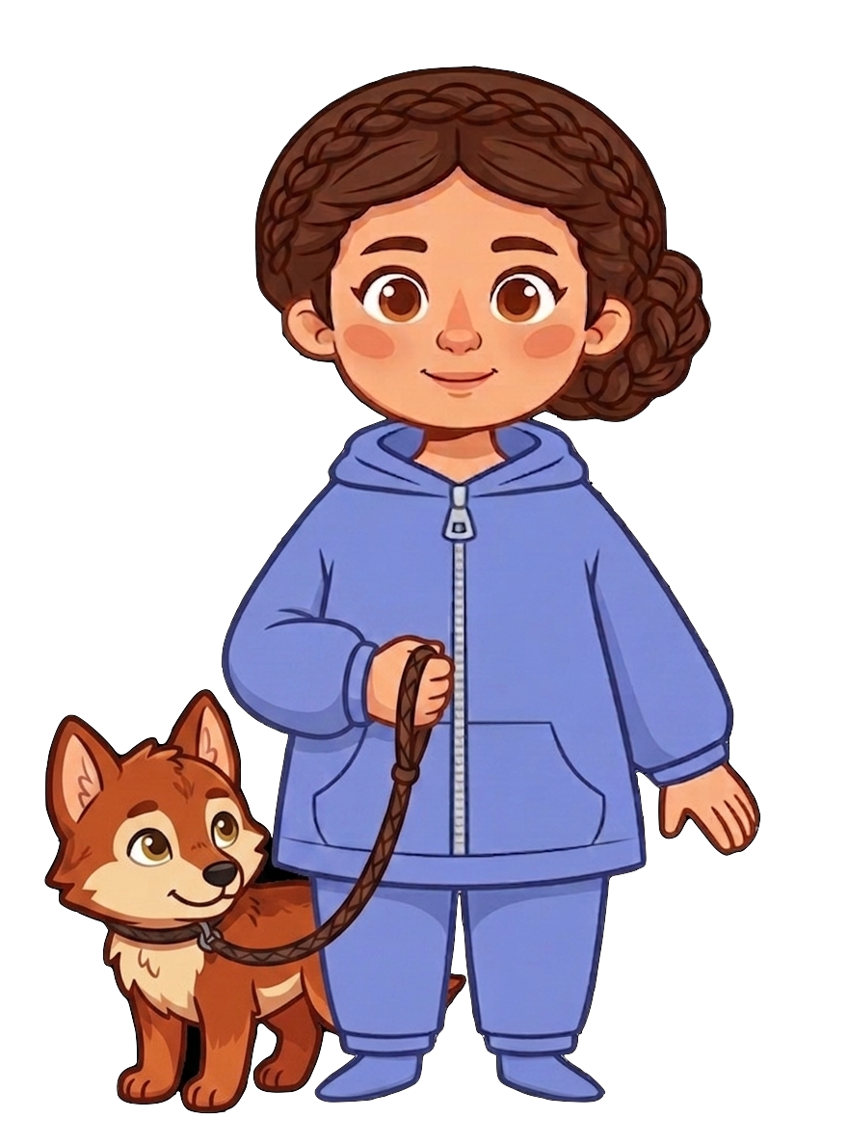
Catherine has a pet wolf

Slide 4
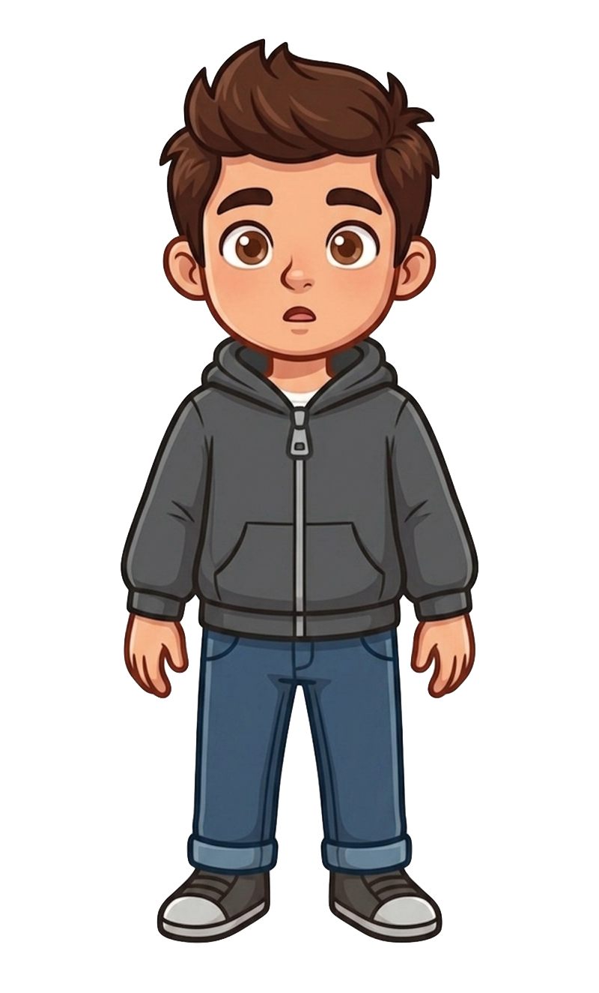
This is Andy

Slide 5
Andy has 2 cookies

Slide 6
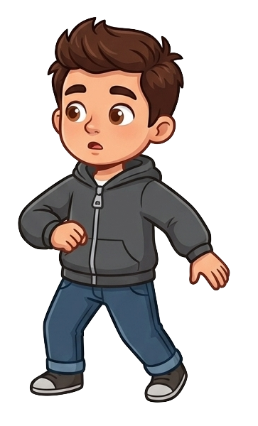
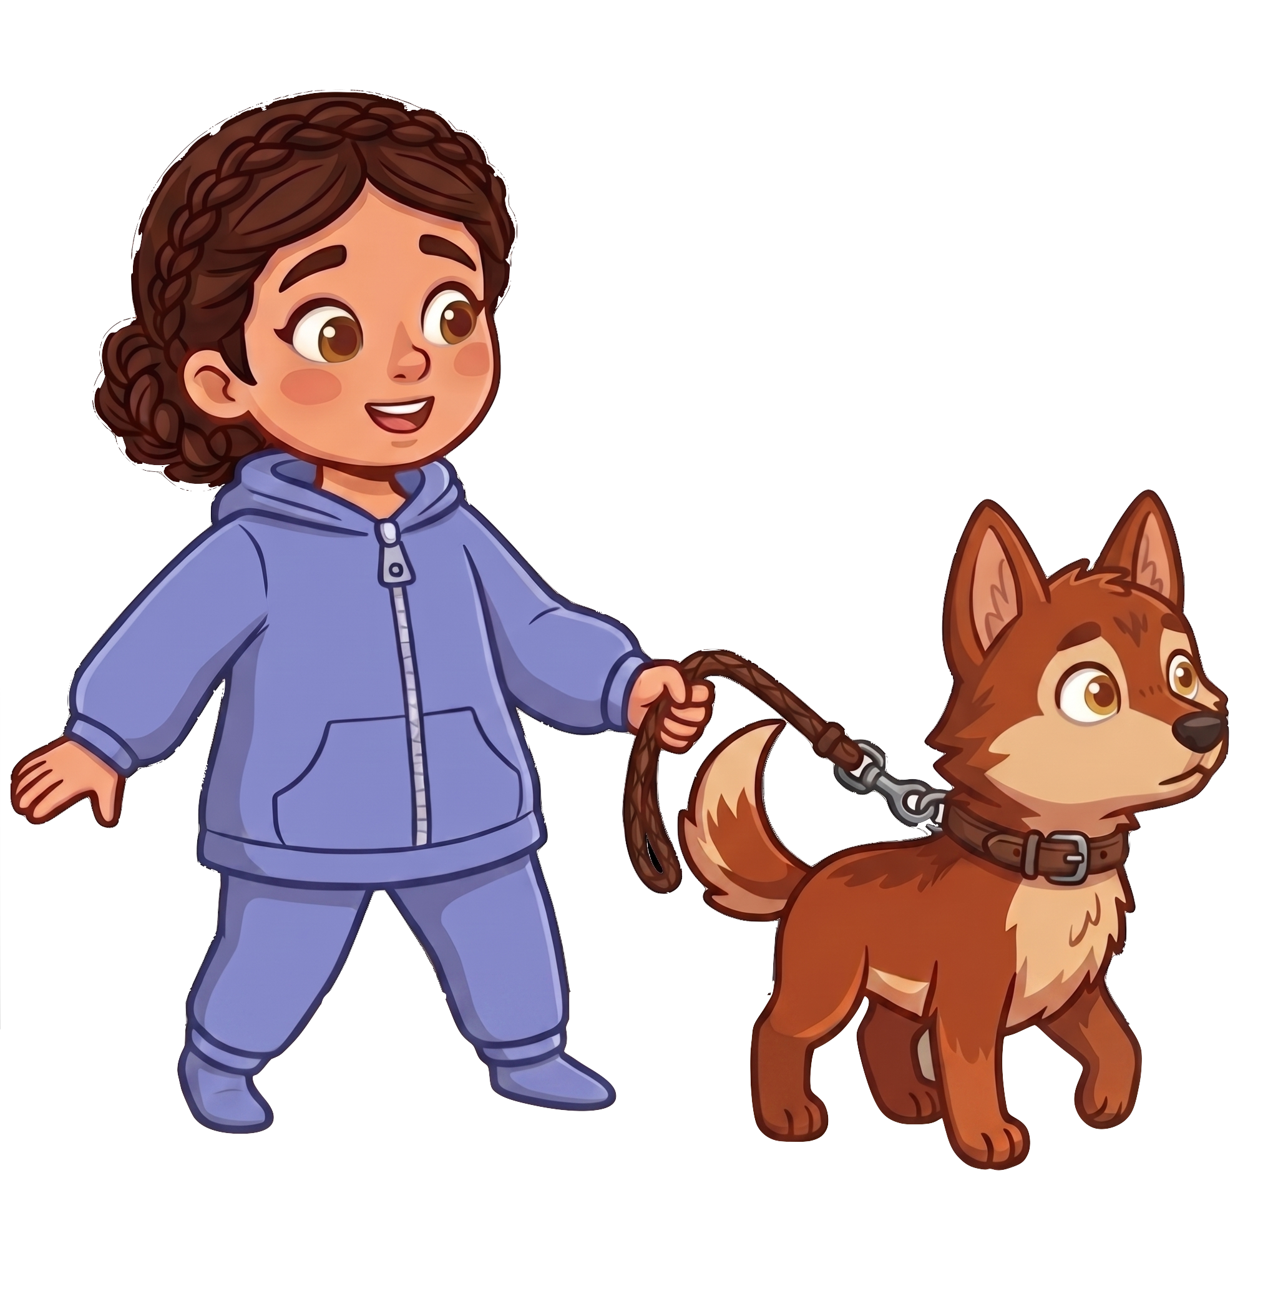
Andy and Catherine bumped into each other accidentally at the corner

Slide 7
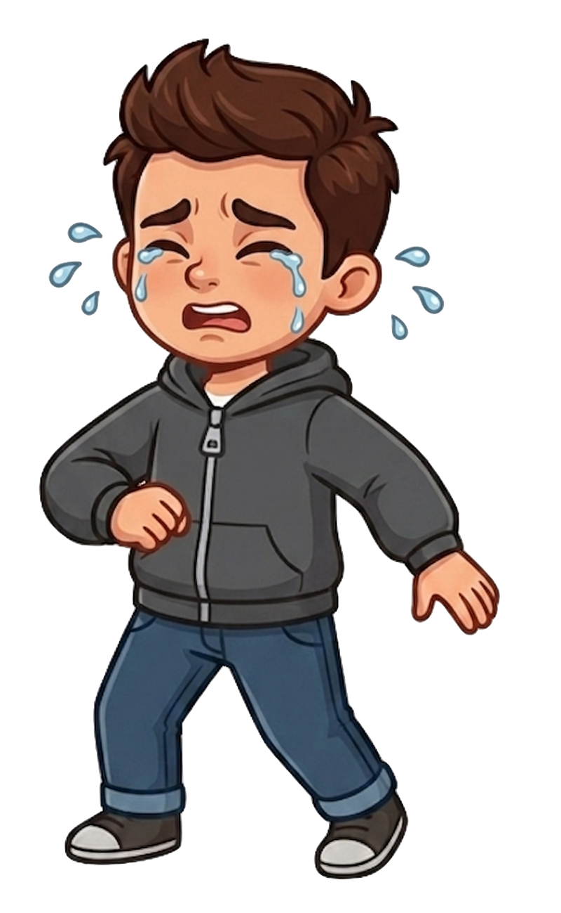
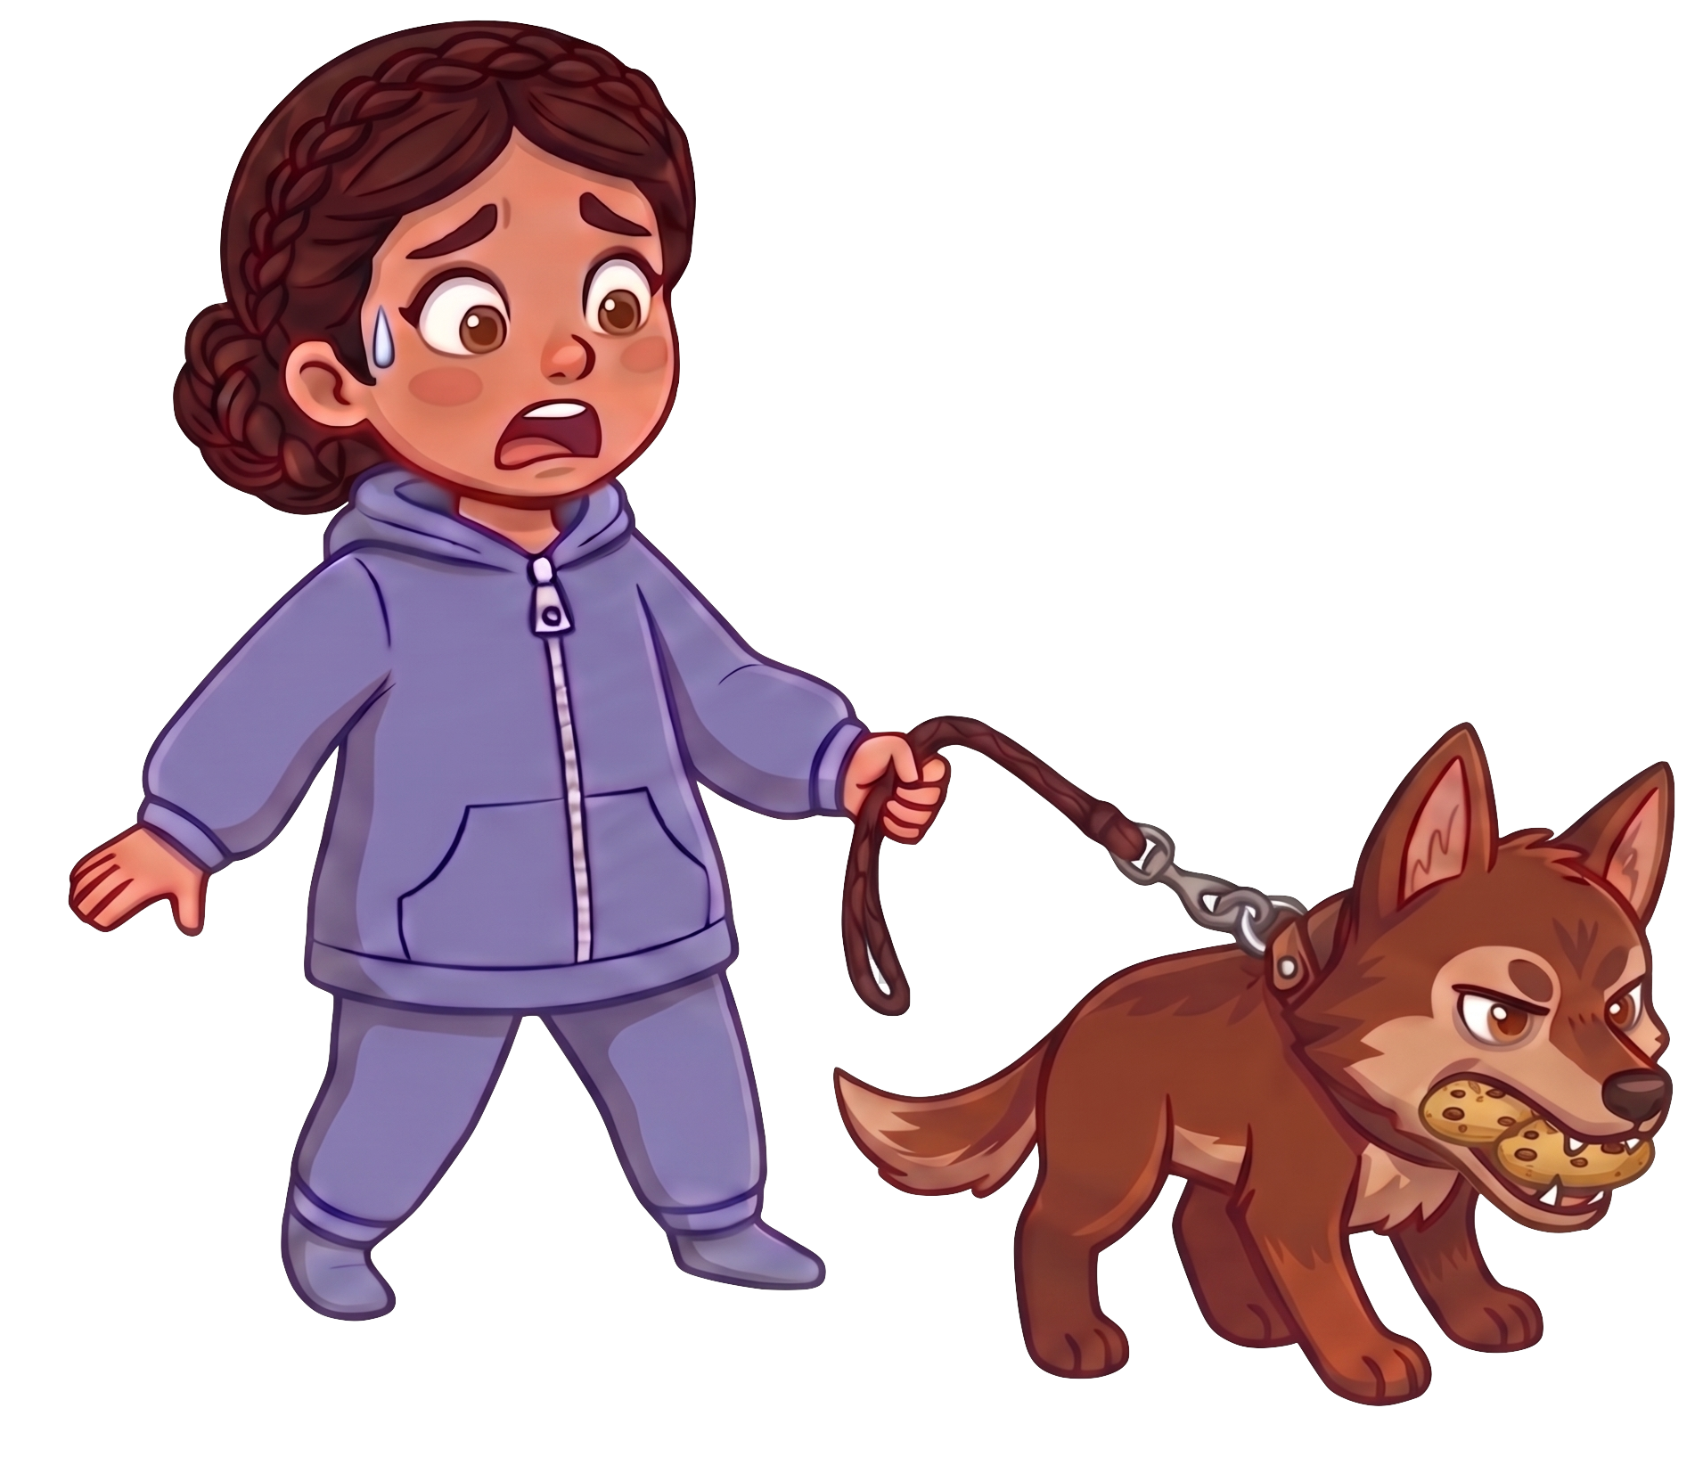
Oh no! The wolf ate 2 of Andy’s cookies!

Slide 8
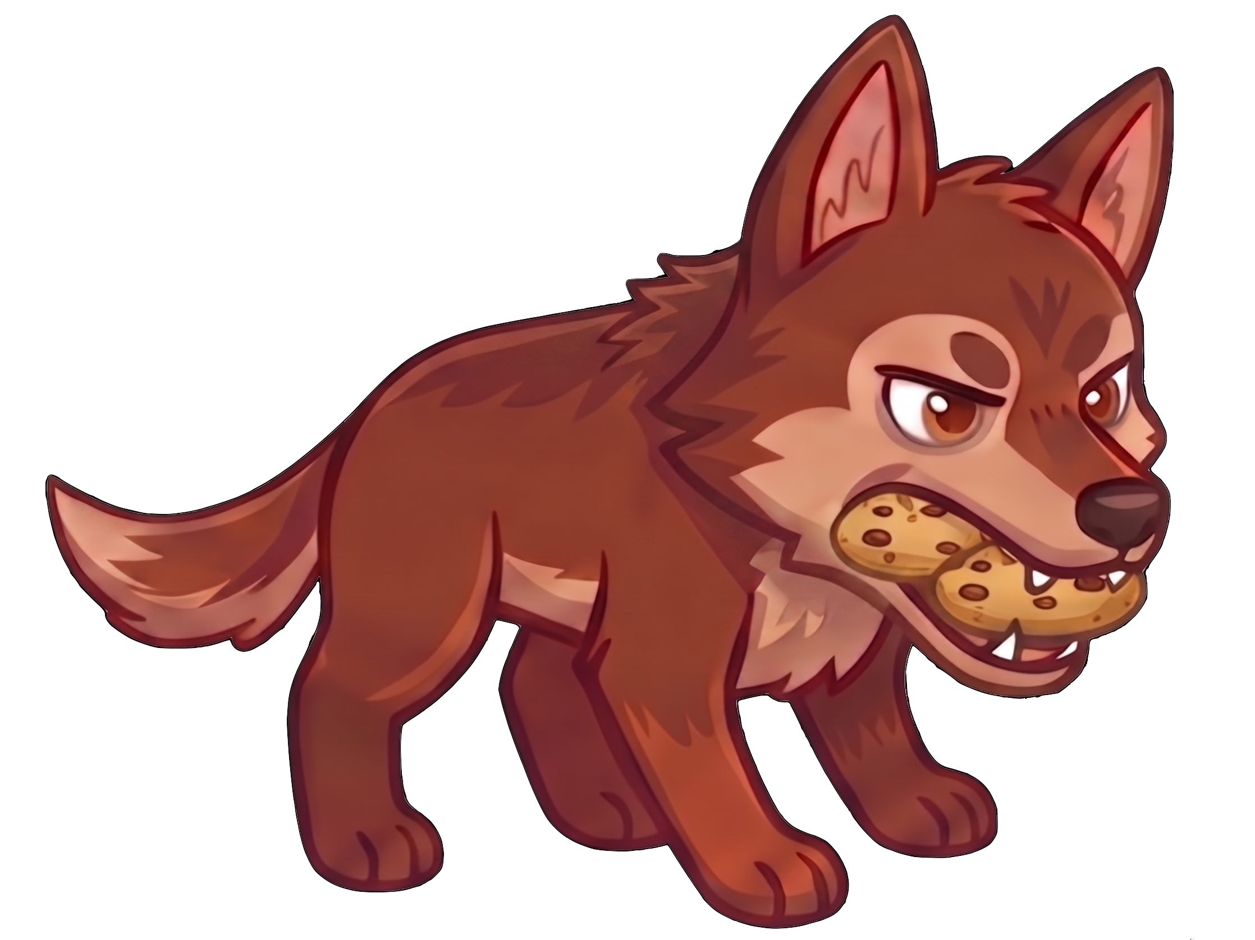
Catherine still has 7 cookies. Andy now has 0 cookies.

